Slide 1

Cart Pendulum Control
Presented by
Ishabahen Polara (40273)
Ritik Mungalpara (40274)
Rutik Lunagariya (40245)
Bansi Thummar (40267)
Parth Savaliya (40278)
Hardik Dudhat (40310)
Under the Guidance of
Prof. Dr.-Ing. Kai Muller
Prof. Dr.-Ing. Karsten Peter

Slide 2
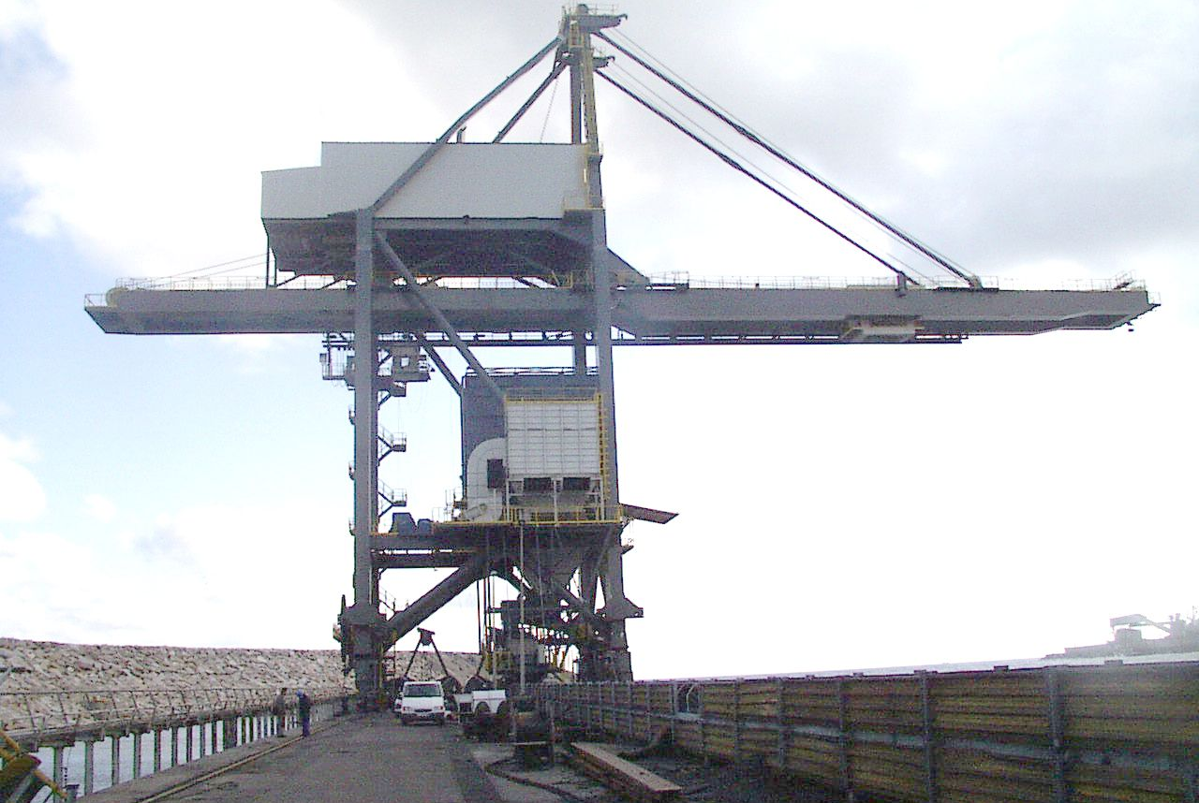
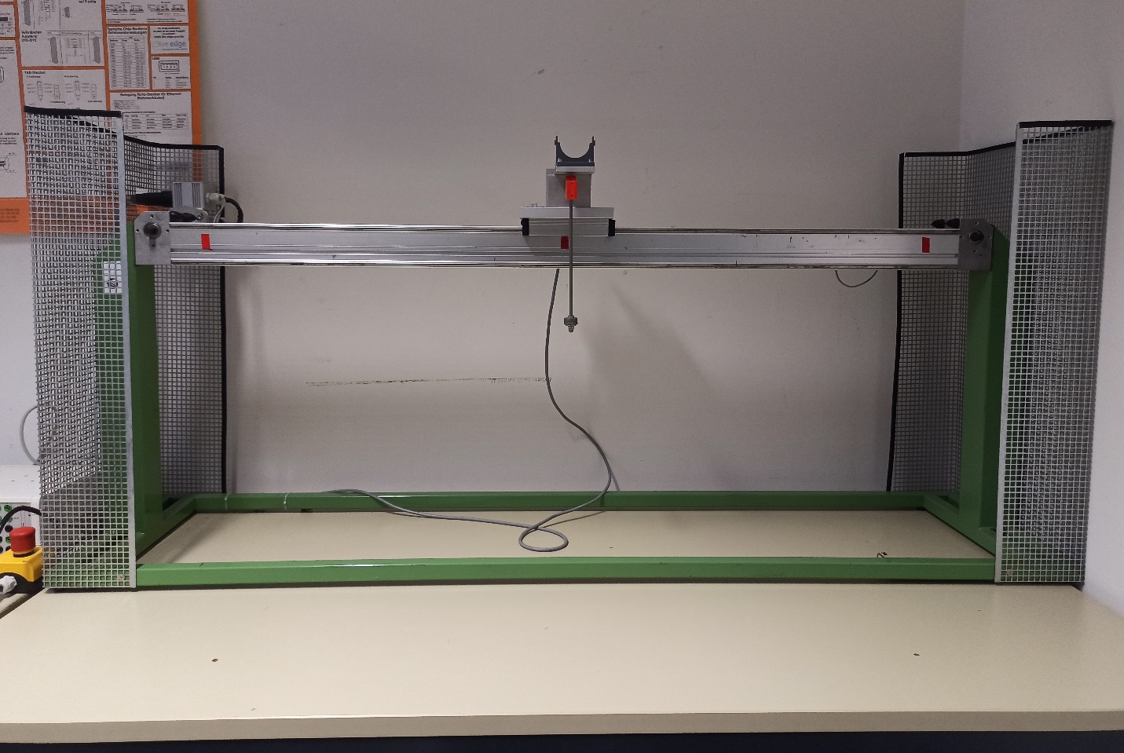
Introduction
Figure: Typical Overhead cranes
Polara(40273)

Slide 3
Mathematical modelling is a method that represents and explains real systems and occurrences to examine, analyse and predict behaviour and events.
The Cart Pendulum System is mathematically characterized by differential equations, with the Lagrange equation serving as the primary framework for its description.
Initially, a set of nonlinear equations is formulated to represent the system's dynamics. To facilitate control using diverse algorithms, the system undergoes linearization that simplify the system.
Polara(40273)

Slide 4
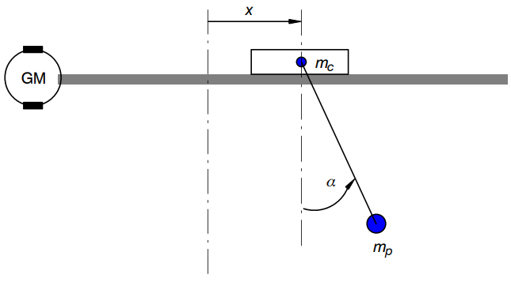
The cart-pendulum system has two degrees of freedom (2-DoF)
Horizontal displacement of cart
Rotation of pendulum around the pivot.
Figure: cart-pendulum system
Polara(40273)

Slide 5
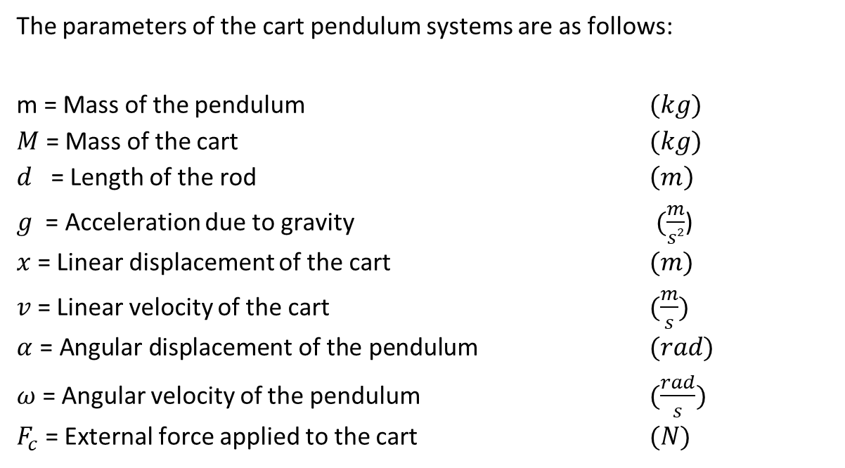
The parameters of the cart pendulum systems are as follows:
$\text{m}$ = Mass of the pendulum $(kg)$
$M$ = Mass of the cart $(kg)$
$d$ = Length of the rod $\left(m\right)$
$g$ = Acceleration due to gravity $(\frac{m}{s2}$)
$x$ = Linear displacement of the cart $(m)$
$v$ = Linear velocity of the cart $(\frac{m}{s})$
$α$ = Angular displacement of the pendulum $(rad)$
$ω$ = Angular velocity of the pendulum $(\frac{rad}{s})$
$F_{c}$ = External force applied to the cart $(N)$
Polara(40273)

Slide 6
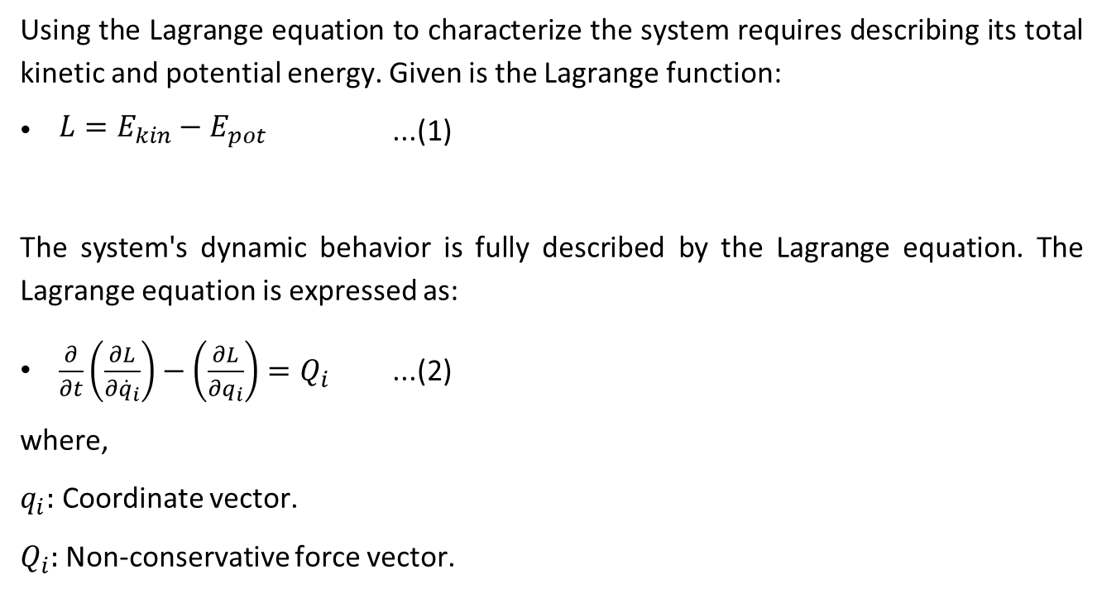
Using the Lagrange equation to characterize the system requires describing its total kinetic and potential energy. Given is the Lagrange function:
$\begin{aligned}L=E_{kin}−E_{pot}\#\end{aligned}$ ...(1)
The system's dynamic behavior is fully described by the Lagrange equation. The Lagrange equation is expressed as:
$\begin{aligned}\frac{∂}{∂t}\left(\frac{∂L}{∂{\overset{˙}{q}}_{i}}\right)−\left(\frac{∂L}{∂q_{i}}\right)=Q_{i}\#\end{aligned}$ ...(2)
where,
$q_{i}:$ Coordinate vector.
$Q_{i}:$ Non-conservative force vector.
Polara(40273)

Slide 7
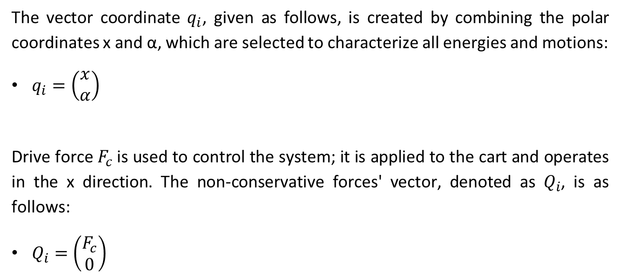
The vector coordinate $q_{i}$, given as follows, is created by combining the polar coordinates x and α, which are selected to characterize all energies and motions:
$q_{i}=\left(\begin{matrix}x \\ α\end{matrix}\right)$
Drive force $F_{c}$is used to control the system; it is applied to the cart and operates in the x direction. The non-conservative forces' vector, denoted as $Q_{i}$, is as follows:
$Q_{i}=\left(\begin{matrix}F_{c} \\ 0\end{matrix}\right)$
Polara(40273)

Slide 8
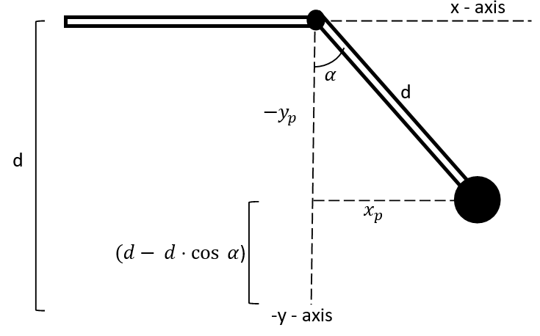
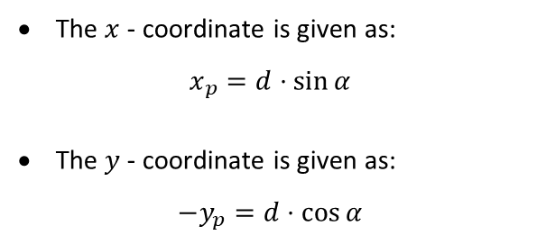
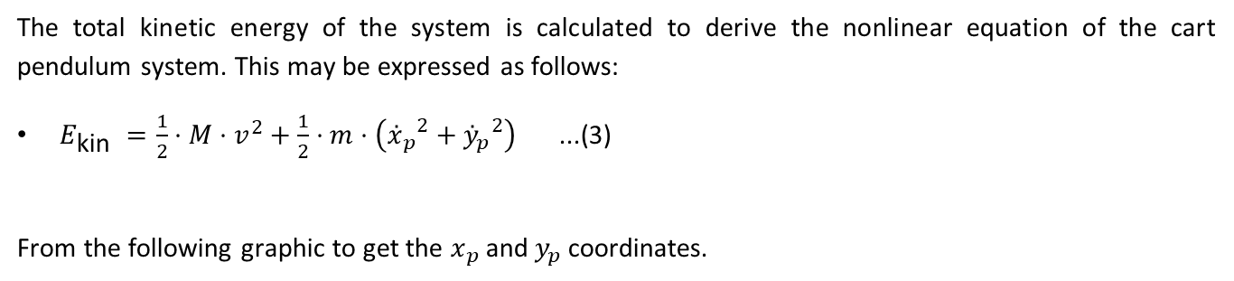
The total kinetic energy of the system is calculated to derive the nonlinear equation of the cart pendulum system. This may be expressed as follows:
$\begin{aligned}E_{\text{kin} }=\frac{1}{2}⋅M⋅v^{2}+\frac{1}{2}⋅m⋅\left({{\overset{˙}{x}}_{p}}^{2}+{{\overset{˙}{y}}_{p}}^{2}\right)\#\end{aligned}$ ...(3)
From the following graphic to get the $x_{p}$ and$y_{p}$ coordinates.
The $x$ - coordinate is given as:
$$x_{p}=d⋅sin⁡α$$
The $y$ - coordinate is given as:
$$−y_{p}=d⋅cos⁡α$$
Polara(40273)

Slide 9
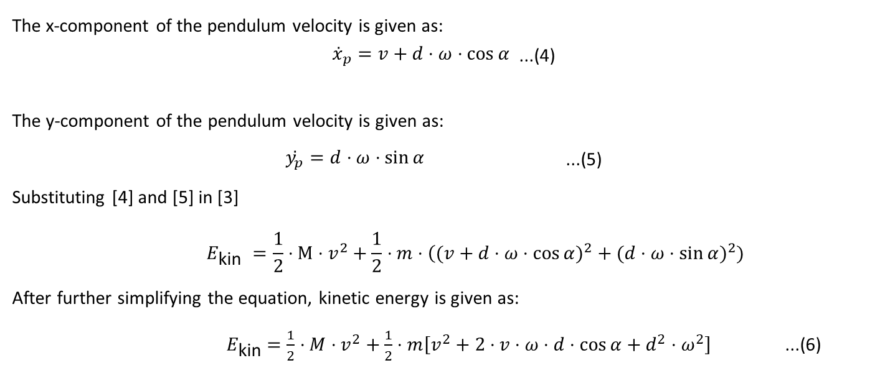
The x-component of the pendulum velocity is given as:
$\begin{aligned}{\overset{˙}{x}}_{p}=v+d⋅ω⋅cos⁡α\#\end{aligned}$ ...(4)
The y-component of the pendulum velocity is given as:
$\begin{aligned}\overset{˙}{y_{p}}=d⋅ω⋅sin⁡α\#\end{aligned}$ ...(5)
Substituting [4] and [5] in [3]
$$\begin{aligned}E_{\text{kin} }=\frac{1}{2}⋅M⋅v^{2}+\frac{1}{2}⋅m⋅\left((v+d⋅ω⋅cos⁡α)^{2}+(d⋅ω⋅\sin{α)^{2}})\right.\#\end{aligned}$$
After further simplifying the equation, kinetic energy is given as:
$\begin{aligned}{ E}_{\text{kin} }=\frac{1}{2}⋅M⋅v^{2}+\frac{1}{2}⋅m\left[v^{2}+2⋅v⋅ω⋅d⋅cos⁡α+d^{2}⋅ω^{2}\right]\#\end{aligned}$ ...(6)
Polara(40273)

Slide 10
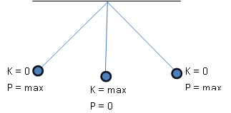
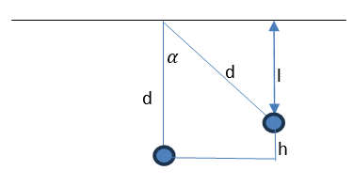
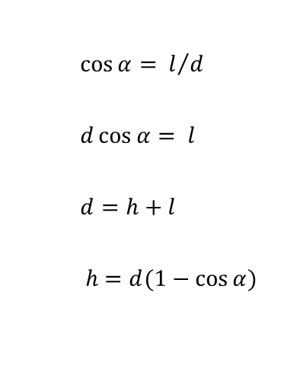
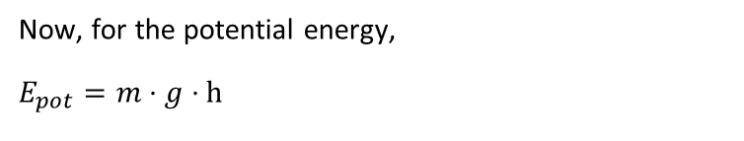
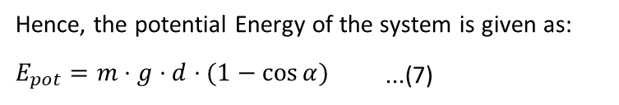
Now, for the potential energy,
$$E_{pot}=m⋅g⋅h$$
$\cos{α}= l/d$
$d\cos{α}= l$
$d=h+l$
$h=d(1−\cos{α})$
Hence, the potential Energy of the system is given as:
$\begin{aligned}E_{pot}=m⋅g⋅d⋅(1−cos⁡α)\#\end{aligned}$ ...(7)
Polara(40273)

Slide 11

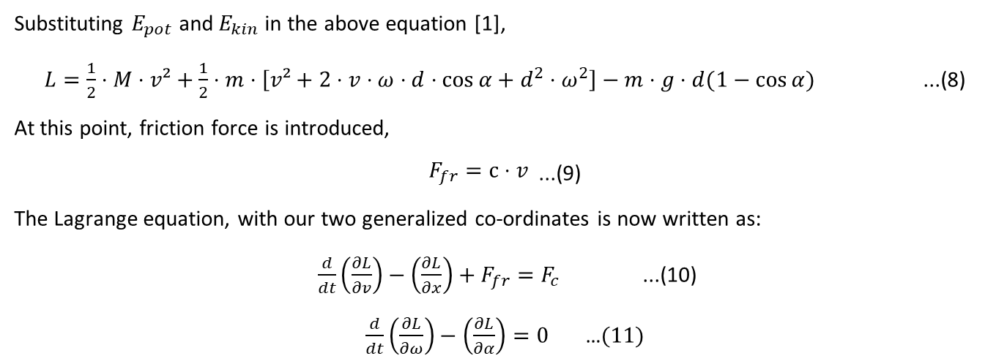
Substituting $E_{pot}$ and $E_{kin}$ in the above equation [1],
$\begin{aligned}L=\frac{1}{2}⋅M⋅v²+\frac{1}{2}⋅m⋅\left[v²+2⋅v⋅ω⋅d⋅cos⁡α+d^{2}⋅ω^{2}\right]−m⋅g⋅d(1−cos⁡α)\#\end{aligned}$ ...(8)
At this point, friction force is introduced,
$\begin{aligned}F_{fr}=c⋅v\end{aligned}$ ...(9)
The Lagrange equation, with our two generalized co-ordinates is now written as:
$\frac{d}{dt}\left(\frac{∂L}{∂v}\right)−\left(\frac{∂L}{∂x}\right)+F_{fr}=F_{c}$ ...(10)
$\frac{d}{dt}\left(\frac{∂L}{∂ω}\right)−\left(\frac{∂L}{∂α}\right)=0$ …$(11)$
Substitute and solve [8] in [10] and [11]
$$\begin{aligned}\overset{˙}{v}⋅(M+m)=F_{c}−m⋅\overset{˙}{ω}⋅d⋅cos⁡α+m⋅ω^{2}sin⁡α−c⋅v\# \\ \overset{˙}{ω}⋅d^{2}⋅m=−\overset{˙}{v}⋅d⋅cos⁡α⋅m−m⋅d⋅g⋅sin⁡α\#\end{aligned}$$
Polara(40273)

Slide 12
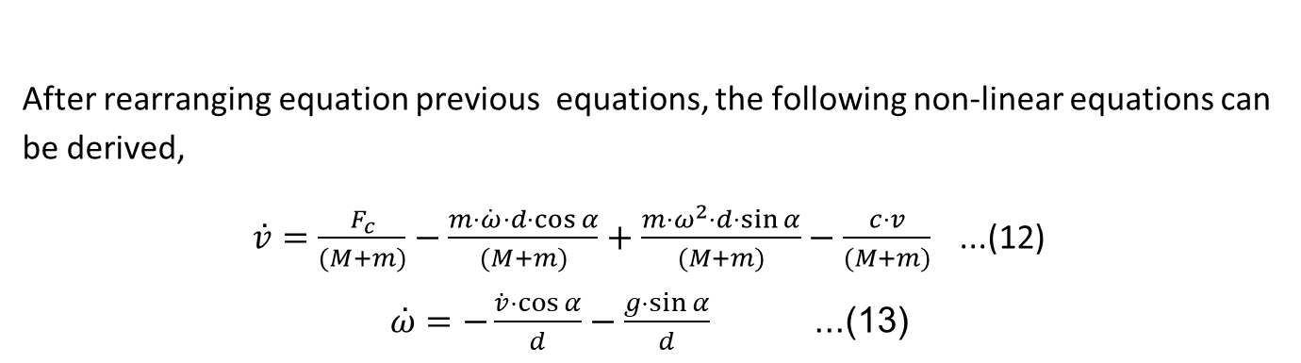
After rearranging equation previous equations, the following non-linear equations can be derived,
$\begin{aligned}\overset{˙}{v}=\frac{F_{c}}{(M+m)}−\frac{m⋅\overset{˙}{ω}⋅d⋅cos⁡α}{(M+m)}+\frac{m⋅ω^{2}⋅d⋅sin⁡α}{(M+m)}−\frac{c⋅v}{(M+m)}\end{aligned}$ ...(12)
$\begin{aligned}\overset{˙}{ω}=−\frac{\overset{˙}{v}⋅cos⁡α}{d}−\frac{g⋅sin⁡α}{d}\#\end{aligned}$ ...(13)
Polara(40273)

Slide 13
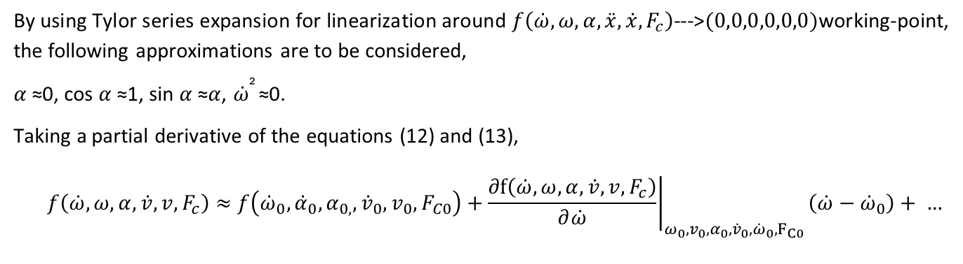
Linearization of Non-Linear model
By using Tylor series expansion for linearization around $f\left(\overset{˙}{ω},ω,α,\overset{¨}{x},\overset{˙}{x},F_{c}\right)$--->$(0,0,0,0,0,0)$working-point, the following approximations are to be considered,
𝛼 ≈0, cos 𝛼 ≈1, sin 𝛼 ≈𝛼, $\overset{˙}{ω}$² ≈0.
Taking a partial derivative of the equations (12) and (13),
$$\begin{matrix} & f\left(\overset{˙}{ω},ω,α,\overset{˙}{v},v,F_{c}\right)≈f\left({\overset{˙}{ω}}_{0},{\overset{˙}{α}}_{0},α_{0,},{\overset{˙}{v}}_{0},v_{0},F_{C0}\right)+{\left.\frac{∂f\left(\overset{˙}{ω},ω,α,\overset{˙}{v},v,F_{c}\right)}{∂\overset{˙}{ω}}\right|}_{ω_{0},v_{0},α_{0},{\overset{˙}{v}}_{0},{\overset{˙}{ω}}_{0},F_{C0}}\left(\overset{˙}{ω}−{\overset{˙}{ω}}_{0}\right)+ … \\ & \end{matrix}$$
After substituting the values in [12] and [13], the following linear equation,
$\dot{v}=\frac{F_{c}}{M}+\frac{m⋅g}{M}⋅α−\frac{c⋅v}{M}$ ...(14)
$\overset{˙}{ω}=−\frac{F_{c}}{M⋅d}−\frac{g⋅(M+m)}{M⋅d}⋅α+\frac{c⋅v}{M⋅d}$ ...(15)
Polara(40273)

Slide 14
Thank you

Slide 15
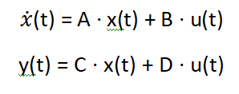
State Space Representation of Linear Model
For linear systems, it is possible to write the state-space representation in the following way:
where,
A is 𝑛𝑥𝑛 System Matrix
B is 𝑛𝑥𝑝 Input Matrix
C is 𝑞𝑥𝑛 Output Matrix
D is 𝑞𝑥𝑝 Feed-through Matrix
Mungalpara(40274)

Slide 16
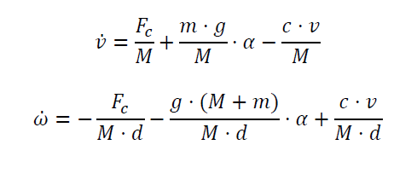
From above equation state-space representation of linear cart pendulum system is given as:
= +
y(t) = + 0 u(t)
Mungalpara(40274)

Slide 17
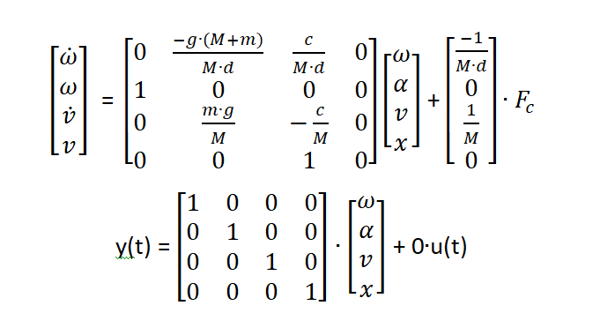
From above equation state-space representation of linear cart pendulum system is given as:
Mungalpara(40274)

Slide 18
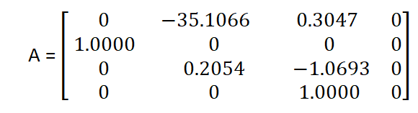
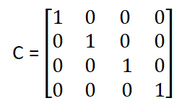
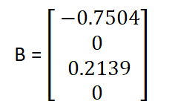
The measured physical parameters of the system on test stand as follows:
𝑀= 4.676 Kg, 𝑚 = 0.098 Kg
d = 0.285 m, 𝑔 = 9.8, c = 5;
The linear cart pendulum system is fully represented by the matrices A, B, C, and D.
D = 0
Mungalpara(40274)

Slide 19
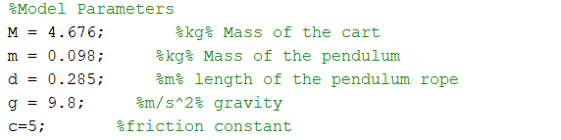
MATLAB Modelling and Simulation of Cart Pendulum System
1. Nonlinear Model:-
MATLAB CODE:-
Mungalpara(40274)

Slide 20
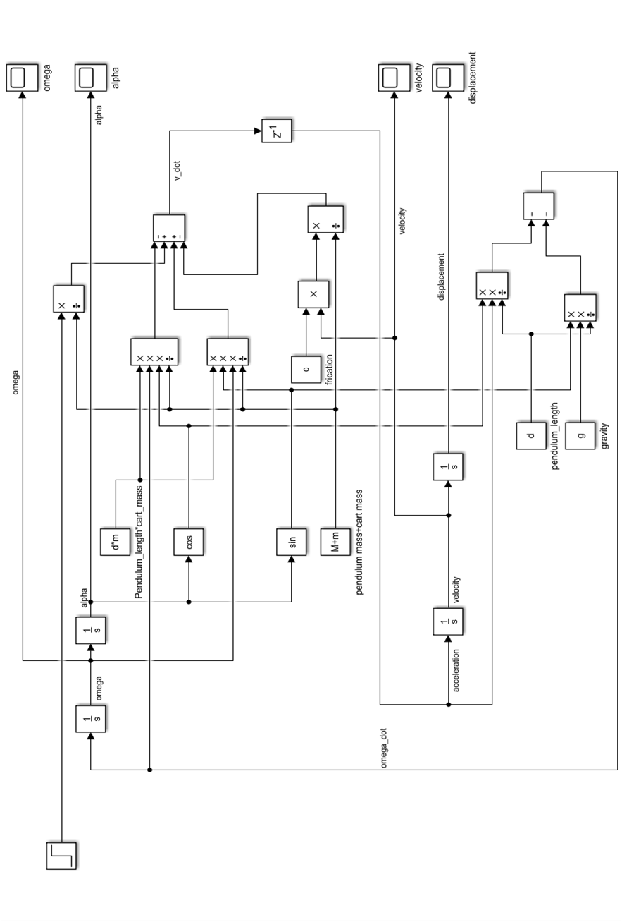
Simulink Model:-
Mungalpara(40274)

Slide 21
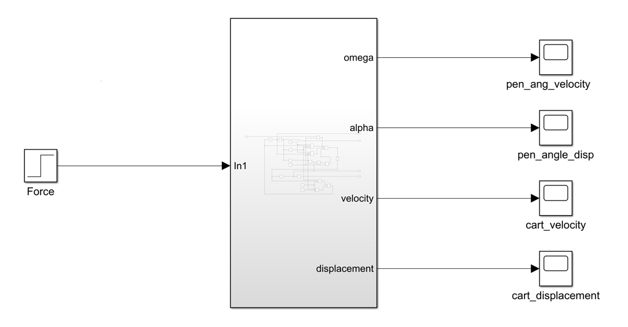
Mungalpara(40274)

Slide 22
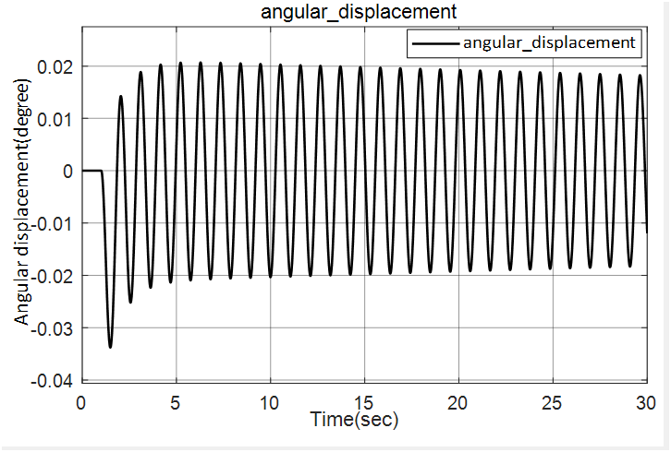
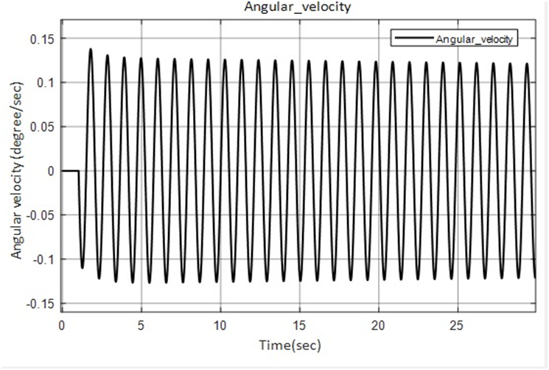
Output Graphs For Non-Linear Model
Mungalpara(40274)

Slide 23
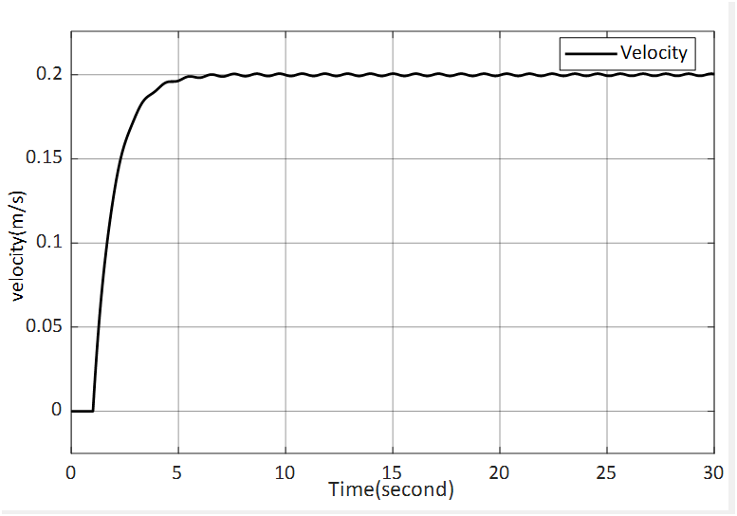
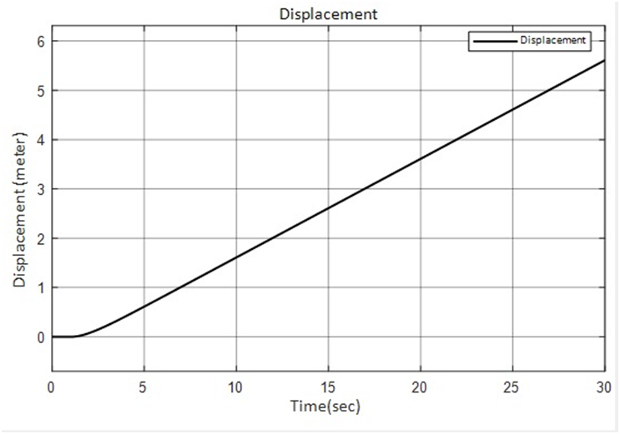
Mungalpara(40274)

Slide 24
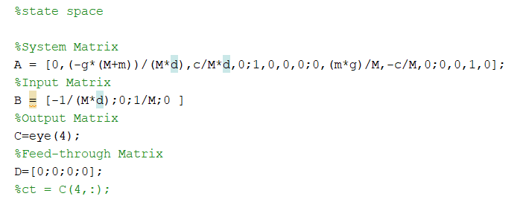
2. Linear Model:-
MATLAB CODE:-
Mungalpara(40274)

Slide 25
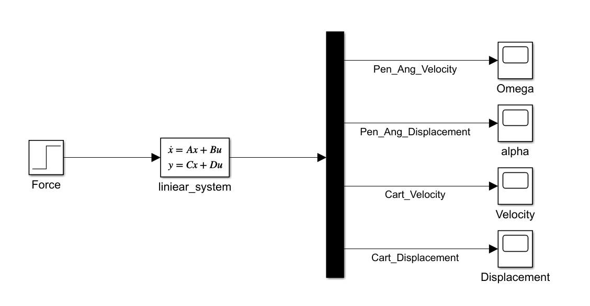
Simulink Model:-
Figure illustrates the linear model of cart pendulum system. The linear system is modelled using state-space block in Simulink. Input to the system is force 𝐹. The initial condition is set to 𝑥=0, 𝑥̇=0, 𝛼̇=0, 𝛼=0 i.e., the state of rest. The outputs of the system observed are cart displacement, cart velocity, pendulum angular displacement and pendulum angular velocity.
Mungalpara(40274)

Slide 26
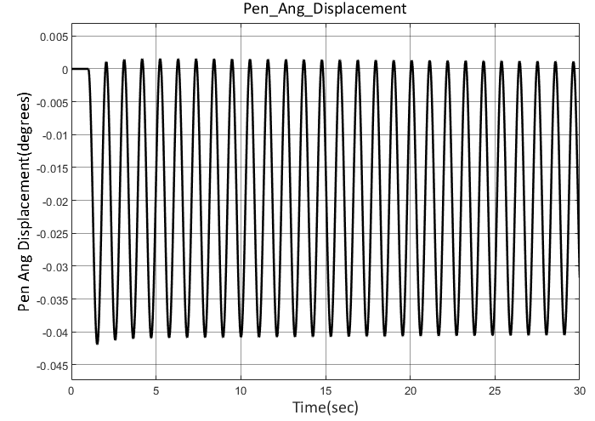
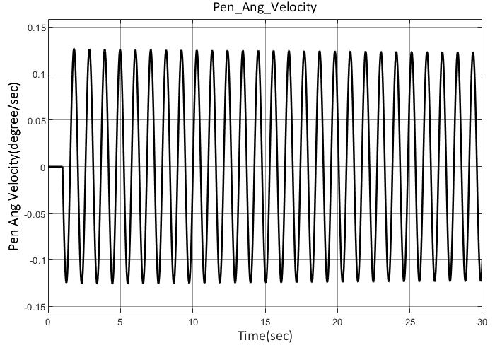
Output Graphs For Linear Model
Mungalpara(40274)

Slide 27
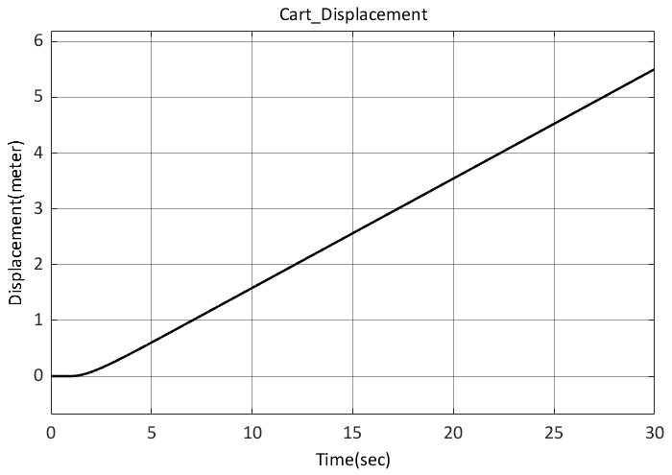
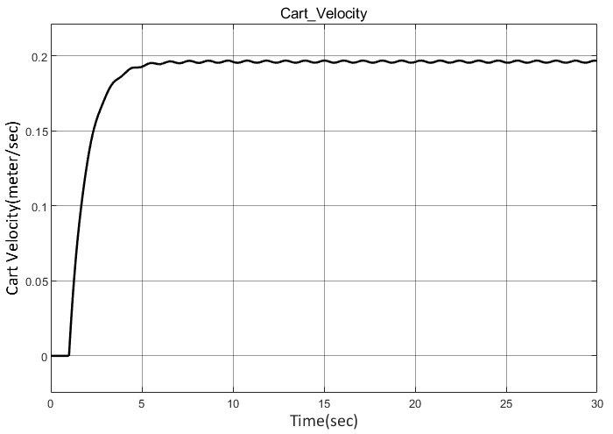
Mungalpara(40274)

Slide 28
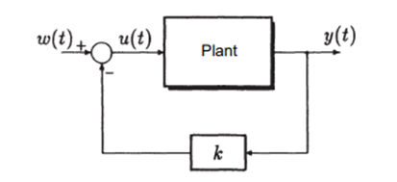
Cart Position Controller
State Feedback System
The state-feedback controller would utilize these matrices along with the desired control objectives to design a controller that can manipulate the system's states to achieve the desired behaviour or performance.
Mungalpara(40274)

Slide 29
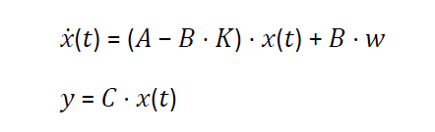
The state space equations for the closed loop system are given as:
State feedback allows to place every single pole at any desired location in the left half of the 𝑠-plane while preserving the stability of the system. The placement of poles is done using Ackermann's formula.
Mungalpara(40274)

Slide 30
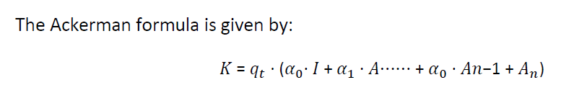
where,
𝐾 : State-feedback vector
𝑞𝑡 : Last row of the inverse of controllability matrix
𝛼 : Coefficients of the desired polynomial obtained by pole placement
Mungalpara(40274)

Slide 31
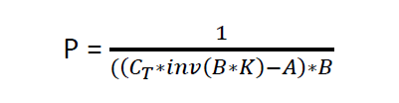
Proportional Controller
Output feedback in a control system restores steady-state accuracy despite step disturbances by amplifying the error between the reference and output values with a proportional gain 𝑃 and feeding it back to the system. This feedback affects the closed-loop poles, requiring modification of the state-feedback gain vector to compensate for the pole shift.
This is called 𝑃 controller or proportional controller.
Mungalpara(40274)

Slide 32
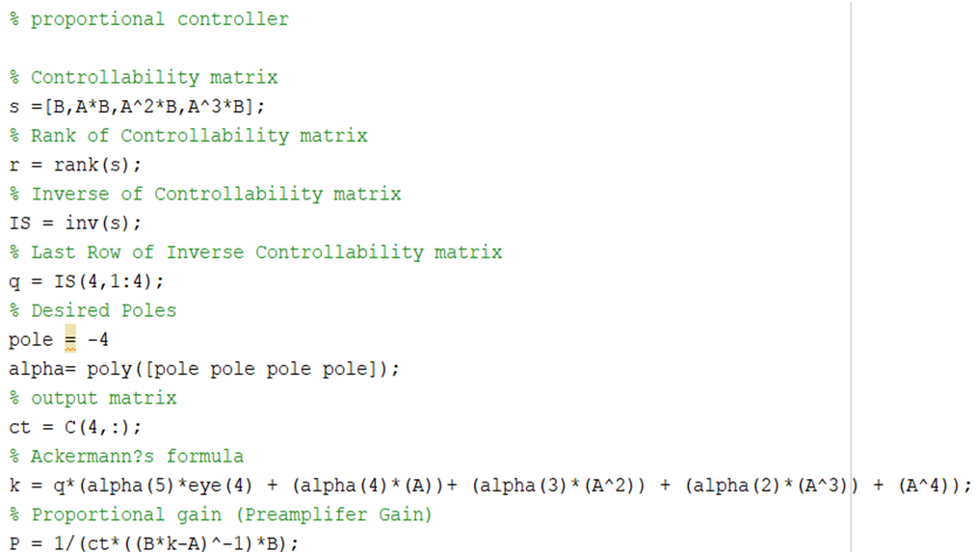
MATLAB script for proportional controller
Mungalpara(40274)

Slide 33
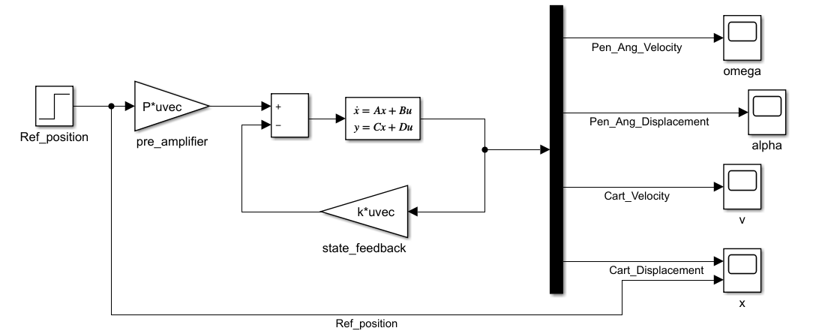
Simulation
Mungalpara(40274)

Slide 34
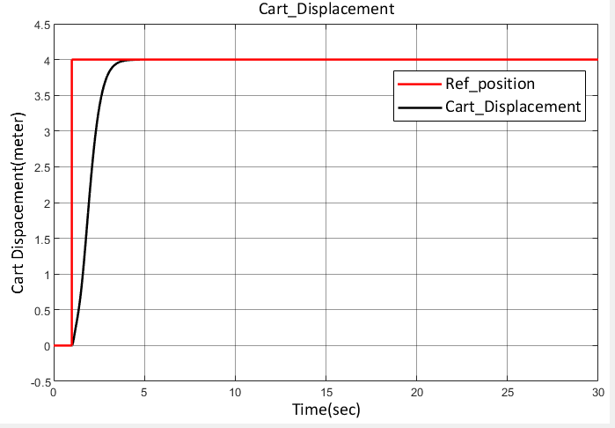
Simulation Result
Mungalpara(40274)

Slide 35
Thank you

Slide 36
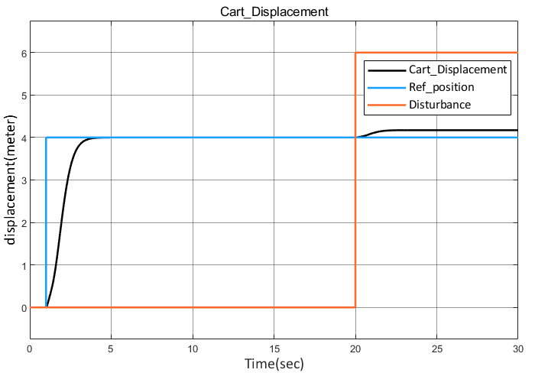

Why are we using PI controller ?
Lunagariya(40245)

Slide 37
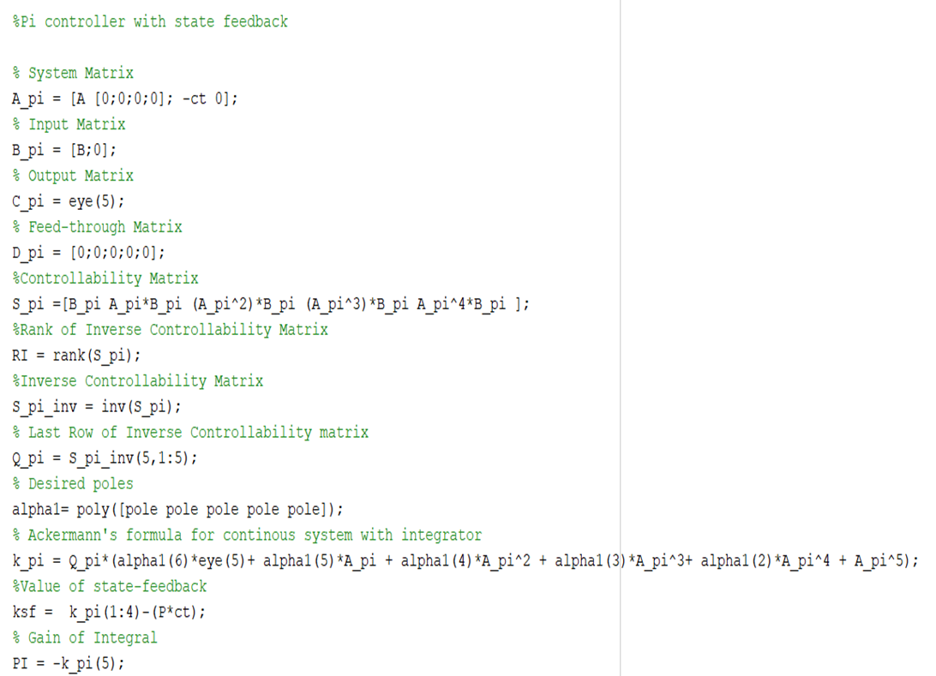
Method to find integral gain of PI controller
Matlab code
Lunagariya(40245)

Slide 38
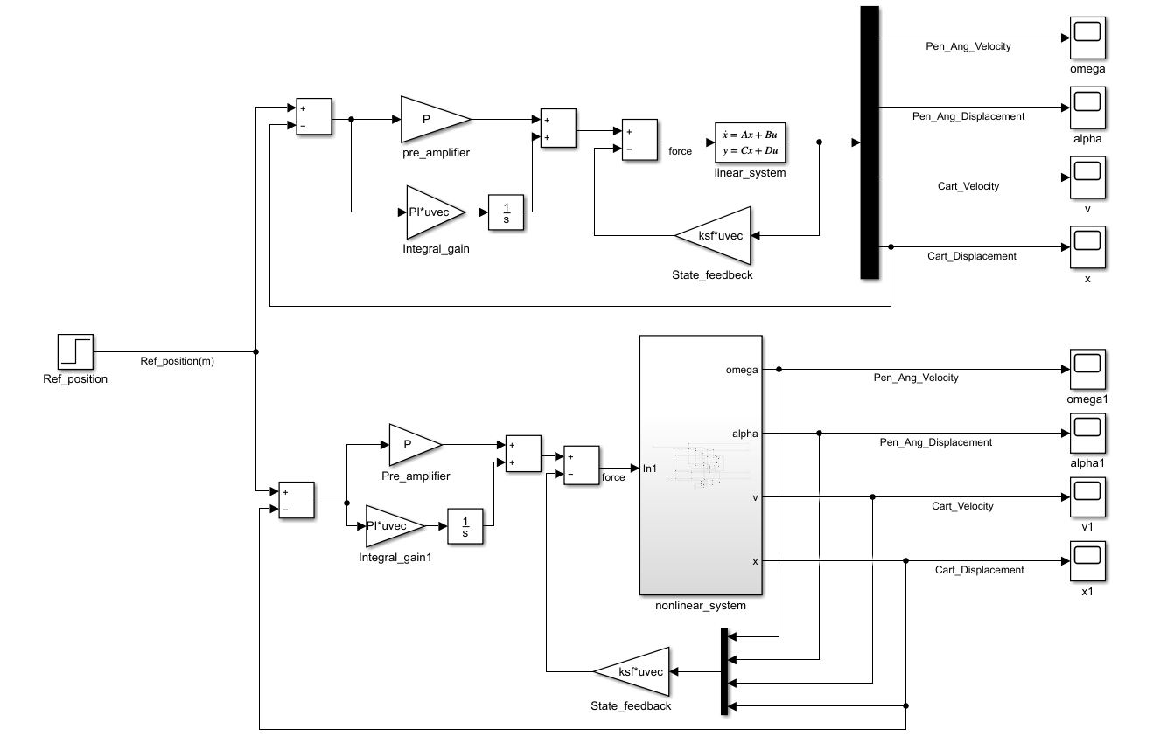
Simulink Model
Lunagariya(40245)

Slide 39
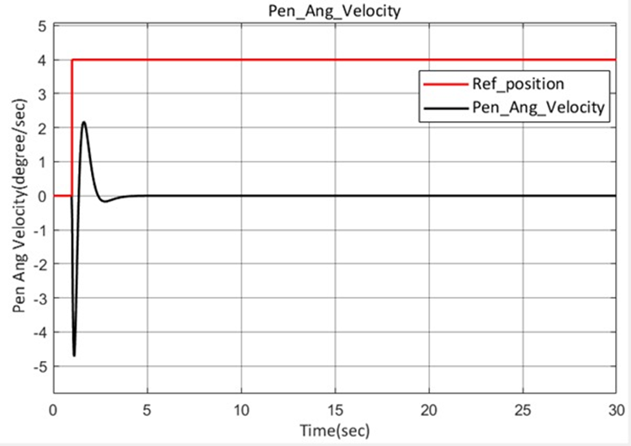
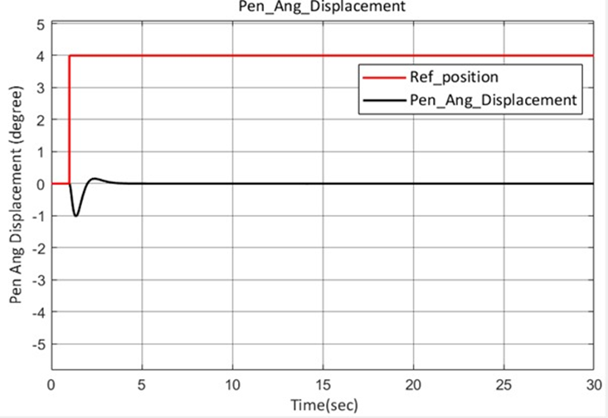
Output Graphs for linear
Above graphs shows pendulum angular displacement and velocity of linear model without disturbances. Reference position of 4m is applied. It is seen that pendulum swings up-to -1 degrees initially because of the applied input, and the oscillation gradually settles to zero degree due to controller effect.
Lunagariya(40245)

Slide 40
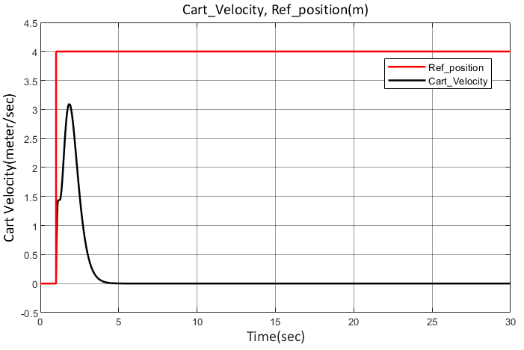

Above figure illustrates the cart displacement and velocity of linear model without disturbances. Reference position of 4m is applied as input. The cart reaches the desired steady state accuracy in 4 secs.
Lunagariya(40245)

Slide 41


Output Graphs for non-linear
Above figures shows pendulum angular displacement and velocity of nonlinear model without disturbances. Reference position of 4m is applied. It is seen that pendulum swings up-to -1 degrees initially because of the applied input and the oscillation gradually settles to zero degree due to controller effect. In the nonlinear model it is observed that the oscillations are more when compared to linear model and oscillations settle down with some delay.
Lunagariya(40245)

Slide 42


Above illustrates the cart displacement and velocity of nonlinear model without disturbances. Reference position of 4m is applied. The cart reaches desired steady state accuracy in 5 secs. Its take 1 more second to stable as compare to linear system.
Lunagariya(40245)

Slide 43

Disturbance Effect
Lunagariya(40245)

Slide 44


Output graphs for linear
Above Figure shows angular displacement and angular velocity of pendulum in the linear model. The disturbance of 20 second duration is applied. An external force induced with a value of 2, Even after disturbance is applied, the pendulum oscillation eventually settles down to 0 degree due to controller’s effect.
Lunagariya(40245)

Slide 45


Above Figure shows the cart displacement observed when disturbance to the pendulum is applied in the linear model. Reference input applied is 4m. The cart position oscillations around the reference position to control the pendulum oscillation and eventually settles at 4.
Lunagariya(40245)

Slide 46


Output graph for non-linear
Above Figure shows angular displacement and angular velocity of pendulum in the nonlinear model. The disturbance of 20 second duration is applied. An external force induced with a value of 2, Even after disturbance is applied, the pendulum oscillation eventually settles down to 0 degree due to controller’s effect.
Lunagariya(40245)

Slide 47


Above Figure illustrates the cart displacement and velocity of nonlinear model with disturbances. Reference position of 4m is applied. The cart reaches desired steady state accuracy in 5 secs.
Lunagariya(40245)

Slide 48

Time Discrete PI Controller with Disturbance
Lunagariya(40245)

Slide 49




Output graph for linear
Lunagariya(40245)

Slide 50




Output graph for non-linear
Lunagariya(40245)

Slide 51

A simple free-body diagram of a cart pendulum is drawn as shown in the figure.
Cart Speed Controller
From the Newton’s equations of motion,
𝐹 − 𝑐 ∙ 𝑉 − 𝑀 ∙ (𝑑𝑉/𝑑𝑡) = 0
𝑀 ∙ (𝑑𝑉/𝑑𝑡) = 𝐹 − 𝑐 ∙ V
In laplace domain the equation is M*s*V = F - c
V =[1/(M*s + c)]*F
Lunagariya(40245)

Slide 52

Then our transformation gain is
G = 1/(M*s+c)
Where G = V/F [1]
Our total gain K is the sum of both proportional gain P and integral gain PI which is multiplied by the integral value 1/s(s-domain) which is given as: K = P + (PI/s)
K = (P*s + PI)/s [2]
From equation 1 and 2
K*G =
By comparison we get,
PI = P*(c/M)
Lunagariya(40245)

Slide 53


MATLAB Code
Lunagariya(40245)

Slide 54

Simulink Model Speed controller
Lunagariya(40245)

Slide 55

Cart velocity
Reference velocity of 1m/sec is applied and it is observed that the cart velocity reaches reference velocity with in 2 sec.
Lunagariya(40245)

Slide 56


Simulink Mode (Discrete)
In this graph Reference velocity of 1m/s is applied and cart reach this velocity with in 2 sec
Lunagariya(40245)

Slide 57
Thank you

Slide 58
Hardware Components
Schematic Diagram of Cart Pendulum System
Incremental Encoder
Violin Amplifier
Linear Actuator LEZ3
DC Servo Motor
End Switches
Arty Z7 Board
Thummar(40267)

Slide 59

Schematic Diagram of Cart Pendulum System
Hardware setup of Cart Pendulum System
Thummar(40267)

Slide 60

Incremental Encoder
Incremental Encoder:
Rotating instrument generating pulses in response to rotation.
Functionality:
A and B channels provide position, direction and speed.
Reference mark (Z) establishes a reference point.
Servo Motor Integration:
Common in servo motors for detailed shaft movement.
Benefits:
Built-in integration in servomotors.
Enables precise movement control.
Incremental Encoder
Thummar(40267)

Slide 61

Violin Amplifier
Amplifier Modes:
Operates in two modes.
Current mode for torque control.
Current Mode Operation:
Calculates motor current.
Directly controls DC motor torque.
Control Signals:
Controlled by Amplifier Enable and Current Command Input.
Operating Status:
Output signal: Amplifier OK.
Indicates amplifier operating status.
Violin Amplifier
Thummar(40267)

Slide 62

Linear Actuator LEZ3
LEZ3 Linear Actuator:
Equipped with toothed belt drive.
Carriage moves to user-specified position.
Drive Mechanism:
Toothed belt for cart positioning.
Requires no maintenance or lubrication.
Advantages:
Increased accuracy for long axis lengths.
Rubber teeth enable positive locking for high force transmission.
LEZ3 linear actuator
Thummar(40267)

Slide 63
DC Servo Motor
Motor MV 300
Rated power | 330 W
Rated speed | 3300 (min-1)
Rated torque / peak torque | 100 / 539 Nm
Rated current / peak current | 6.5 / 30 A
Motor Encoder
Power Supply | 5 V DC
Resolution | 1000 PPR
Servo Motor Overview:
For high-precision rotation.
Electric motor with a control circuit.
Feedback Mechanism:
Control circuit provides position feedback.
Enables precise rotations.
Types:
AC and DC Servo Motors.
Operation:
DC Servo Motor: Operates with DC power.
AC Servo Motor: Operates with AC power.
Thummar(40267)
Parameter of Motor MV 300

Slide 64

End Switch
Functionality:
The switch in a reversible motor system controls forward or
backward motion by its position or movement.
Triggers electronic signal.
Efficiency and Axis Detection:
Energy-efficient design.
Suitable for detecting end positions on X, Y, and Z axes.
Operating Specifications:
Handles up to 125 V AC/DC.
End Switches
Thummar(40267)

Slide 65

Arty Z7 Board
Arty Z7 Overview:
Development platform with Zynq-7000™ AP SoC.
Integrates dual-core ARM Cortex-A9 processor with Xilinx 7-series FPGA logic.
Architecture:
ARM processor surrounded by customizable peripherals for specific applications.
Toolsets:
Vivado, Petalinux, and SDSoC for defining custom peripherals.
Integration into Linux or bare-metal programs.
Flexibility:
Option to bypass ARM processors for traditional digital logic design.
Zynq FPGA programmable like other Xilinx FPGAs.
Arty Z7 board
Thummar(40267)

Slide 66
Hardware Interface
Interface of the board and the components
Digital to Analog Conversion (DAC)
Analog-to-Digital Convertor (ADC)
Up & Down Counter
SPI Protocol
Thummar(40267)

Slide 67

Interface of the board and the components
Hardware Interface Circuit:
Connects SoC, limit switches, violin amplifier, and encoders.
Utilizes CMOS in SoC for low power and high noise immunity.
Prefers TTL for 5V components due to cost and robustness against interference.
Data Conversion:
DAC converts SoC digital data to analog for violin amplifier.
Enables seamless communication between components.
The interface of the interface board and the components
Thummar(40267)

Slide 68

Digital to Analog Conversion (DAC)
DAC AD5624R Overview:
Utilized in this application.
Performs two main functions:
Increases light intensity through four output channels.
Provides internal reference voltage to the ADC.
Working with DAC:
FPGA transmits appropriate data bits for effective operation.
DAC Input Shift Register
Thummar(40267)

Slide 69
Digital to Analog Conversion (DAC)
C2 | C1 | C0 | Command
0 | 0 | 0 | Write to input register n
0 | 0 | 1 | Update DAC register n
0 | 1 | 0 | Write to input register n, update all (software LDAC)
0 | 1 | 1 | Write to and update DAC channel n
1 | 0 | 0 | Power down DAC (power-up)
1 | 0 | 1 | Reset
1 | 1 | 0 | LDAC register setup
1 | 1 | 1 | Internal reference setup (on/off)
Sr.No. | Operation | Input Shift register Bits
1 | Reset DAC | 0x280001
2 | Power-Up DAC | 0x20000F
3 | LDAC Register Mode | 0x300000
4 | Internal Reference | 0x380001
DAC Input bits
Command Definition of the DAC
Thummar(40267)

Slide 70
Analog-to-Digital Convertor (ADC)
AD7886 Overview:
High-performance 12-bit ADC for precise, efficient data acquisition.
For projects that require 16-bit data, with the option of using two ADCs for better resolution.
Operates on ±5 V power supplies.
Thummar(40267)

Slide 71
Up & Down Counter
Up Counting:
90-degree phase shift between A and B signals.
Pulse cycle dissected into four states.
Counter increments when A and B produce the same sequence.
Up-pulse designated in pulse pattern.
Down Counting:
Encoder transmits specific pulse pattern.
Counter decreases when A and B generate the same sequence.
Dn-pulse designated in pulse pattern.
Thummar(40267)

Slide 72

Up & Down Counter
Up & Down Counter
Thummar(40267)

Slide 73

SPI Protocol
Introduction:
Communication protocols are the languages for electronic devices.
SPI (Serial Peripheral Interface) is a widely adopted protocol.
It is more straightforward, requiring fewer resources.
Versatility of SPI:
Used in diverse devices like SD card modules, RFID card readers, and wireless transmitters.
Key strength: Ability to transfer data in a continuous stream.
Master-Slave Relationship:
Master (typically a microcontroller) directs communication.
Slave (sensor, display, memory chip) follows instructions.
SPI master and slave interface
Thummar(40267)

Slide 74
SPI Protocol
Essential SPI Lines:
MOSI (Master Output/Slave Input): Master transmits data to slave.
MISO (Master Input/Slave Output): Slave sends data back to master.
SCLK (Clock): Synchronizes timing of data transfer.
SS/CS (Slave Select/Chip Select): Master designates the target slave for communication.
Practical Implementation:
Number of slaves managed constrained by system load capacitance.
Influences the reliability and efficiency of communication.
Thummar(40267)

Slide 75


SPI Protocol
DAC SPI write cycle
Conversion Start and Data Read Timing Diagram of ADC
Thummar(40267)

Slide 76
Cart Pendulum SoC design
SoC design
Cart Pendulum Custom IP Component
SPI VHDL Module
Thummar(40267)

Slide 77

Cart Pendulum SoC design
Thummar(40267)

Slide 78
Cart Pendulum Custom IP Component
Purpose:
Facilitates Arty Z7 FPGA and POXI interface board communication.
IP Utilization:
Utilizes VHDL-developed IP with AXI peripheral and four 32-bit registers.
Functionality:
Integrates chip select distribution, SPI module, and LED drivers.
Manages Arty Z7 board LEDs, switches, pushbuttons, red, and infrared LEDs.
Key Components:
SPI Module: Controls chip select, LED drivers, and communication with POXI board.
Effective Coordination:
Enables seamless operation and communication between FPGA and POXI board.
Thummar(40267)

Slide 79

Cart Pendulum Custom IP Component
IP Block diagram
Thummar(40267)

Slide 80
SPI VHDL Module
Overview:
SPI enables communication between Arty Z7 FPGA and external peripherals
Features:
Configurable 16 and 24-bit data lengths.
Clock phase and polarity adjustments (CPHA and CPOL).
Full-duplex data transfer capability.
Thummar(40267)

Slide 81


Sequential process VHDL code and state diagram for spi pha='0'
VHDL code for spi pha='0'
State diagram for spi pha='0'
Thummar(40267)

Slide 82


Start/Stop and Clock Handling VHDL code and state diagram
VHDL code
SPI start and stop logic state machine
Thummar(40267)

Slide 83
Thank you

Slide 84

Sequential Process Flow for Cart Pendulum Control
Savaliya(40278)

Slide 85
Physical Scaling
MATLAB script for required variables for scaling
P_0 = 1; % Rated cart position (m) P_0k = 57147; % Sensor reading for rated cart position F_0 = 20; % Rated force (N) F_0k = 200; % DAC increments for rated force V_0 = 1; % Rated cart speed (m/s) V_0k = 571.47; % Sensor reading for rated cart speed A_0 = 2*pi; % Rated pendulum angle (rad) A_0k = 4095; % Sensor reading for rated pendulum angle Av_0 = 2*pi; % Rated pendulum angular velocity (rad/s) Av_0k = 40.95;; % Sensor reading for rated pendulum angular velocity
Savaliya(40278)

Slide 86
MATLAB script for controller coefficient
Gp_s = (P_0/P_0k)*P_D*(F_0k/F_0); % Scaled proportional gain Gi_s = (P_0/P_0k)*pi_d*Ts*(F_0k/F_0); % Scaled integral gain ktd_s(1) = (Av_0/Av_0k)*kt_d(1)*(F_0k/F_0); ktd_s(2) = (A_0/A_0k)*kt_d(2)*(F_0k/F_0); ktd_s(3) = (V_0/V_0k)*kt_d(3)*(F_0k/F_0); ktd_s(4) = (P_0/P_0k)*kt_d(4)*(F_0k/F_0); ktd_s = [ktd_s(1) ktd_s(2) ktd_s(3) ktd_s(4)]; % Scaled state feedback vector gain
Savaliya(40278)

Slide 87

MATLAB Simulation for Position Controller
Savaliya(40278)

Slide 88
Simulation Result
Savaliya(40278)

Slide 89

MATLAB Simulation for Speed Controller
Savaliya(40278)

Slide 90
Simulation Result
Savaliya(40278)

Slide 91

Comparison between Legacy Code and MATLAB Model
Savaliya(40278)

Slide 92
Simulation Result Comparison
Savaliya(40278)

Slide 93

State Diagram for Referencing Phase
Savaliya(40278)

Slide 94

State Diagram for Controlling Phase
Savaliya(40278)

Slide 95
Thank you

Slide 96
Graphical User Interface (GUI)
Agenda:-
Overview of GUI
Complete GUI Design
Test Result Analysis
Challeges
Dudhat(40310)

Slide 97

Overview of GUI
What is GUI?
Graphical User Interface (GUI) is a user interface framework that enables users to interact with electronic devices through graphical icons, visual indicators, and other graphical elements.
Implementation of GUI
The GUI for our project was developed using the Eclipse IDE, which serves as a robust development environment specifically designed for Java programming.
Dudhat(40310)

Slide 98

GUI Design
Dudhat(40310)

Slide 99

Control Panel
COM port: Ensure smooth connection between GUI and hardware for seamless experiments.
Display Box: Show cart position, cart velocity, pendulum angle, pendulum velocity, and force for user observation and analysis.
Control Buttons: The interface includes several control buttons, each designed for specific functions.
Dudhat(40310)

Slide 100


Graph & Selection Panel
Graph: Visualizes data for user understanding.
Selection Panel: Choose plots for analysis.
Dudhat(40310)

Slide 101


Console & Input Command Field
Console: Monitors system progress and displays error messages for incorrect input.
Input Command Field: Execute tasks from the GUI by inputting commands in the input command Field.
Dudhat(40310)

Slide 102

Test Result Analysis
Validation on Real-World Hardware: The primary objective of test analysis is to validate the software’s performance in a real-world hardware environment. This involves comparing the software or simulation model’s output with the actual output observed on the hardware during operation.
Need for Software Modification: If the output from the real hardware does not align with the desired or simulated output, it indicates a need for modifications in the software. This ensures that the software performs optimally when deployed in its intended hardware environment.
Dudhat(40310)

Slide 103

Cart Displacement
Disturbance causes an angle in the pendulum, leading to cart movement to reduce pendulum oscillations.
Initial cart movement is approximately 15 cm leftward to stabilize pendulum oscillations.
Dudhat(40310)

Slide 104

Cart velocity
Graph illustrates cart velocity response to disturbance, initially at zero.
Velocity spikes due to external force applied to pendulum from 0.2 to 0.3 seconds.
Cart velocity nears zero after 0.5 seconds, indicating stable pendulum and cart returning to reference position.
Dudhat(40310)

Slide 105

Pendulum velocity
Pendulum velocity starts at zero, peaks between 0.2 and 0.3 seconds due to external force.
Control system activation reduces velocity, stabilizing pendulum within 0.55 seconds.
Dudhat(40310)

Slide 106

Pendulum angle
Graph displays pendulum angle response to disturbance, reaching -43.5 degrees.
Pendulum stabilizes and returns to settled position within 0.55 seconds.
Dudhat(40310)

Slide 107

Force
Chart illustrates force applied in response to pendulum disturbance.
Initial overshoot followed by force stabilization within 0.55 seconds to mitigate pendulum oscillations.
Dudhat(40310)

Slide 108




Test Result
Cart Position
Cart Velocity
Pendulum Angel
Pendulum Velocity
Dudhat(40310)

Slide 109

Test Result
Force
Dudhat(40310)

Slide 110
Challenges Faced During GUI Implementation in Project
Data Retrieval Strategy: To extract data from the C-Code, adopt a two-string approach:
Display String: For showing relevant information.
Graph String: Dedicated to plotting graphs.
Error encountered in string separation process due to uncertainty surrounding the last value within the loop.
Initial graph had only two points.
Software stopped providing continuous data.
Dudhat(40310)

Slide 111

Initial Testing graph 1
Dudhat(40310)

Slide 112
Thank you

